Slide 1


CICD Corporate Automation Pipeline Using DevOps in AWS
Focuses on designing and implementing a comprehensive CI/CD Automation pipeline using DevOps tools.
Team Members:
NAGA VENKATA SIVANIKHIL MARADANI - RA2412033010020
JUJJAVARAPU SUJAN CHOWDARY - RA2412033010001
NAVEEN KUMAR REDDY - RA2412033010029

Slide 2

INTRODUCTION
What is CI/CD?
Continuous Integration (CI): Automates code integration and testing.
Continuous Deployment (CD): Automates the release of validated builds to production.
Why CI/CD Matters in the Corporate World:
Accelerates software delivery cycles.
Enhances collaboration between development and operations.
Ensures high-quality and secure deployments.
RESEARCH AND DEVELOPMENT

Slide 3
OBJECTIVE
Key Features:
Secure infrastructure setup for Kubernetes and virtual machines.
Deployment of essential tools like Jenkins, SonarQube, Nexus, and Docker.
Implementation of vulnerability scanning and artifact management.
Comprehensive monitoring using Prometheus and Grafana.
Technologies Involved:
DevOps Tools: Jenkins, Docker, Kubernetes, Nexus.
Security: Trivy for vulnerability scanning, RBAC for access control.
Monitoring: Prometheus, Grafana, Node Exporter.
End Goals:
Achieve automated, secure, and efficient software delivery.
Demonstrate the CI/CD process with real-time monitoring and alerts.
RESEARCH AND DEVELOPMENT

Slide 4
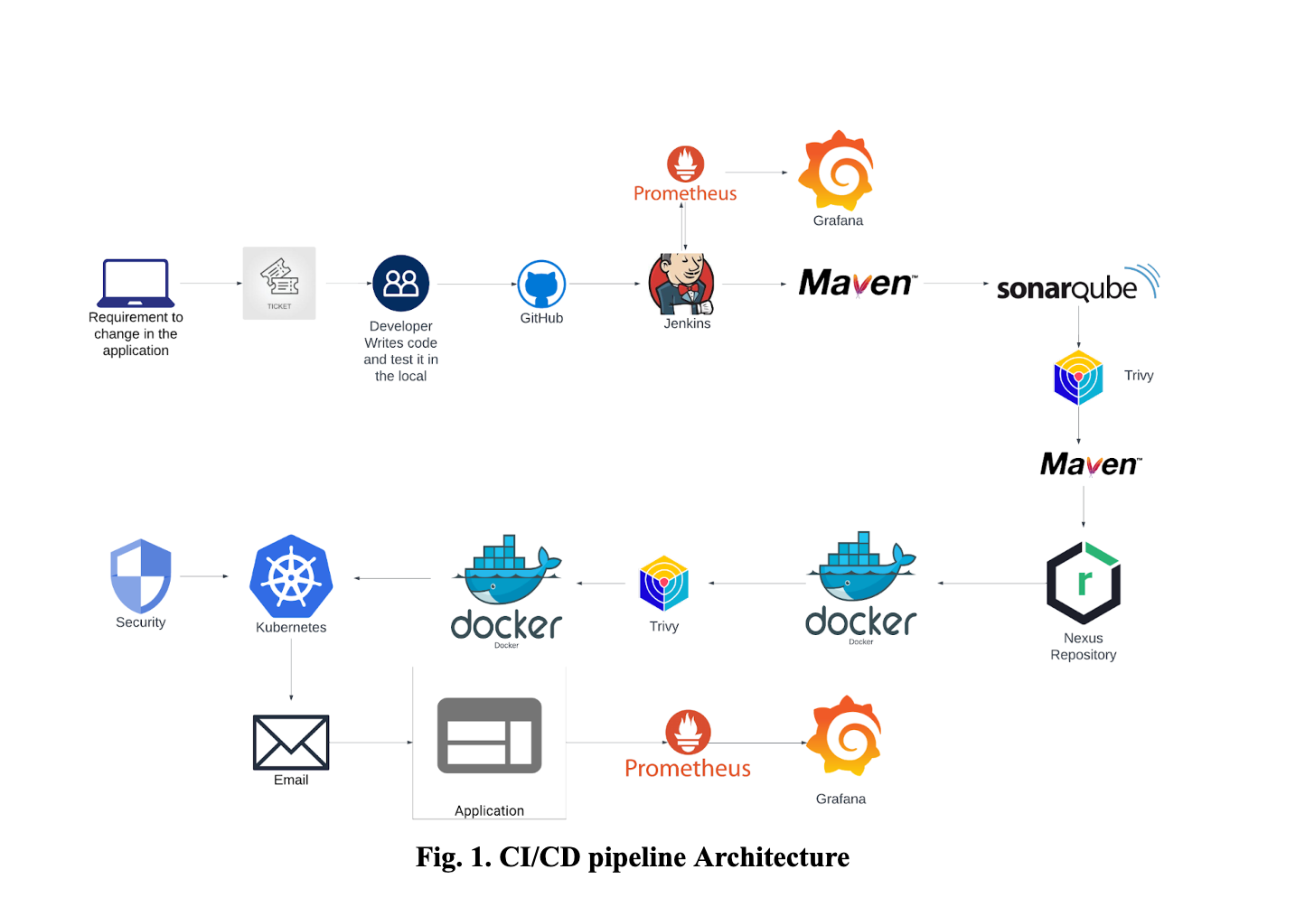
ARCHITECTURE

Slide 5
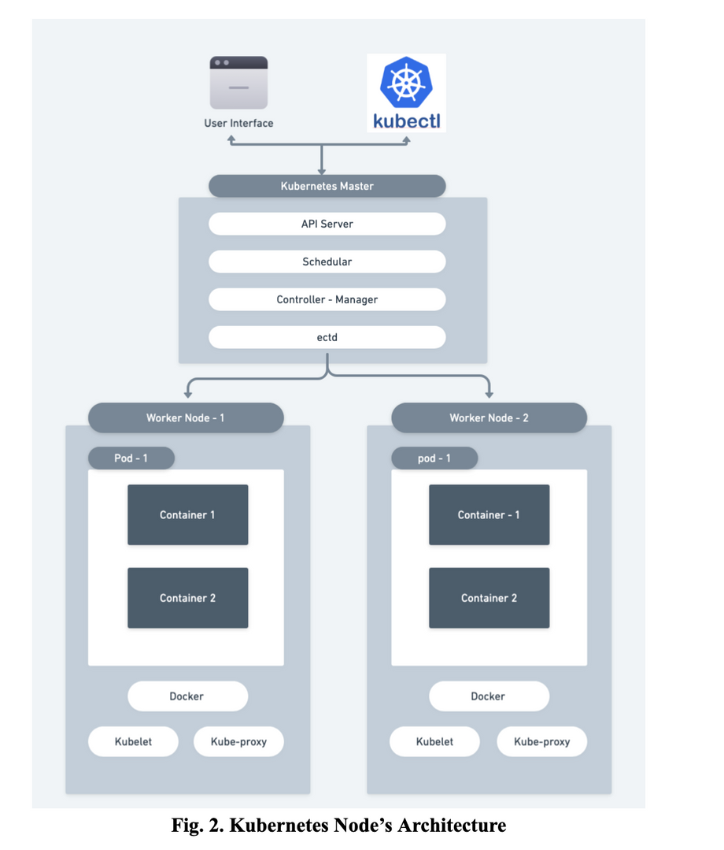
ARCHITECTURE

Slide 6
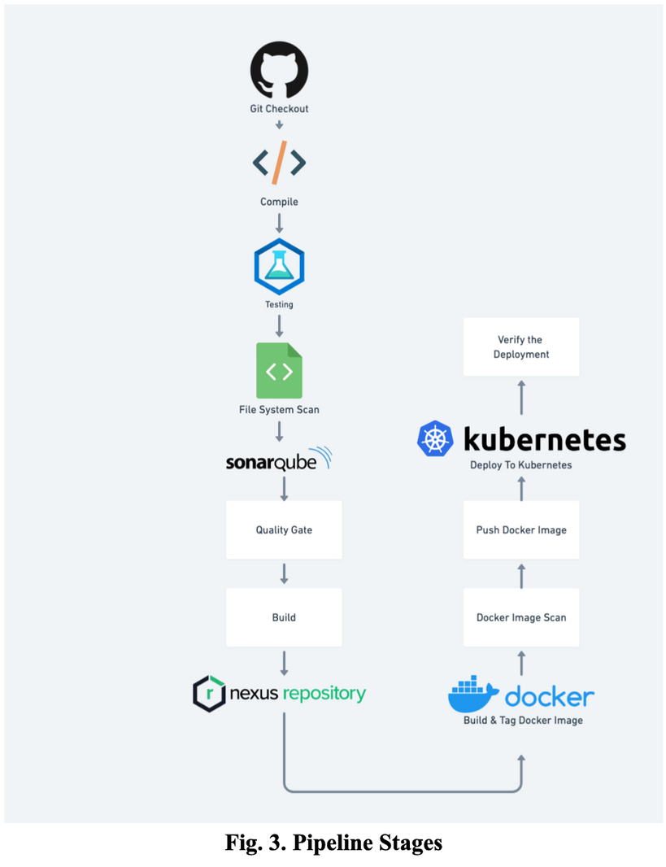
ARCHITECTURE

Slide 7
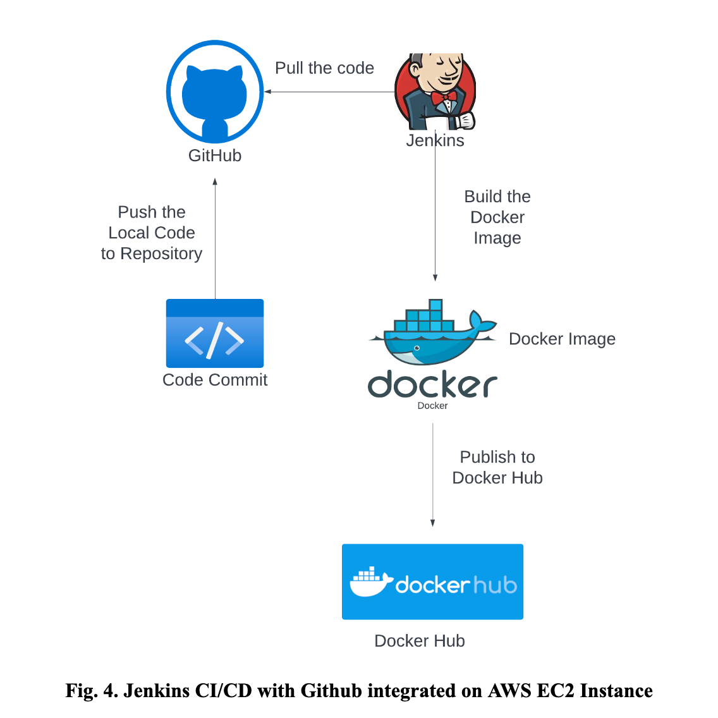
ARCHITECTURE

Slide 8
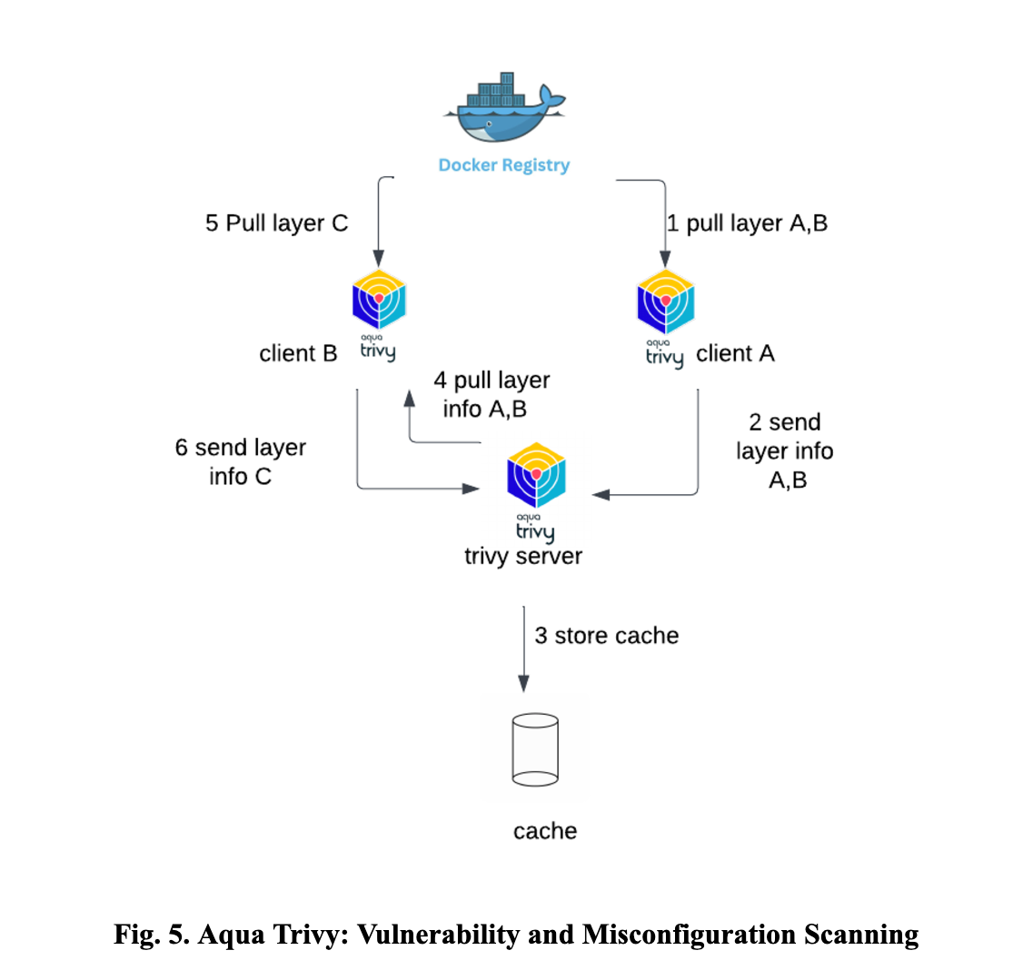
ARCHITECTURE

Slide 9
Enhanced Deployment Efficiency:
Reduced deployment time by automating build, test, and release processes.
Improved Security and Reliability:
Integrated Trivy vulnerability scanning and RBAC for secure deployments.
Continuous monitoring of system and application metrics.
Streamlined Artifact Management:
Efficient artifact storage and distribution using Nexus.
Scalable and Robust Infrastructure:
Kubernetes cluster setup supports seamless scaling and load balancing.
High availability ensured for production-grade deployments.
Actionable Insights:
Real-time monitoring dashboards with Grafana for system and application performance.
Email notifications for build/test results and system health alerts.
RESULTS
RESEARCH AND DEVELOPMENT

Slide 10
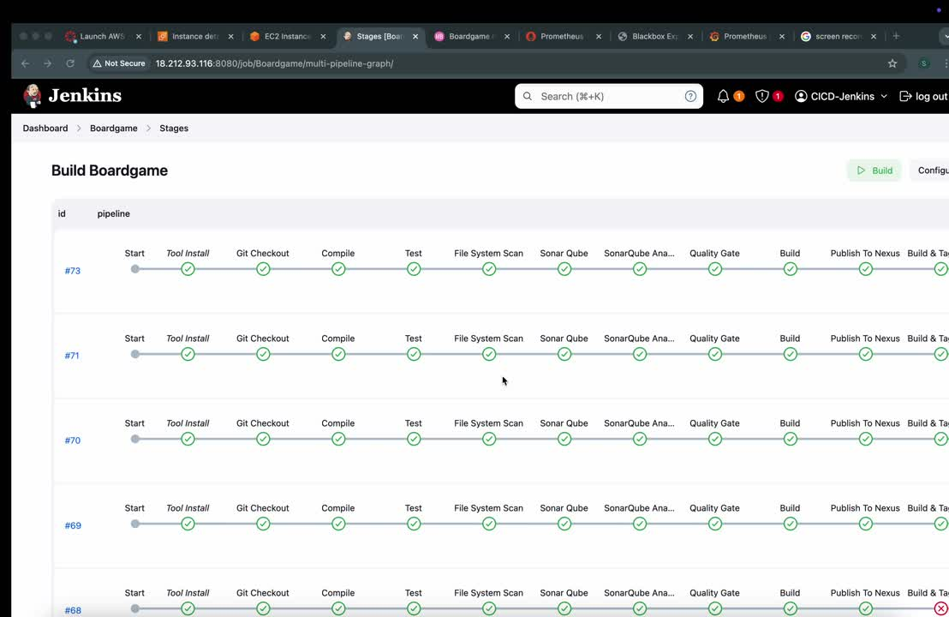
RESEARCH AND DEVELOPMENT

Slide 11
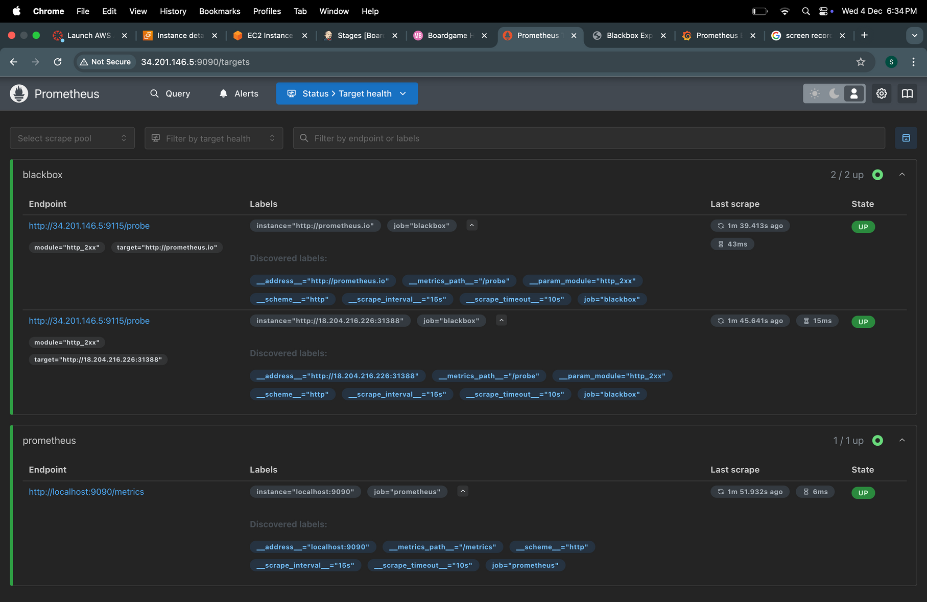
RESULT

Slide 12
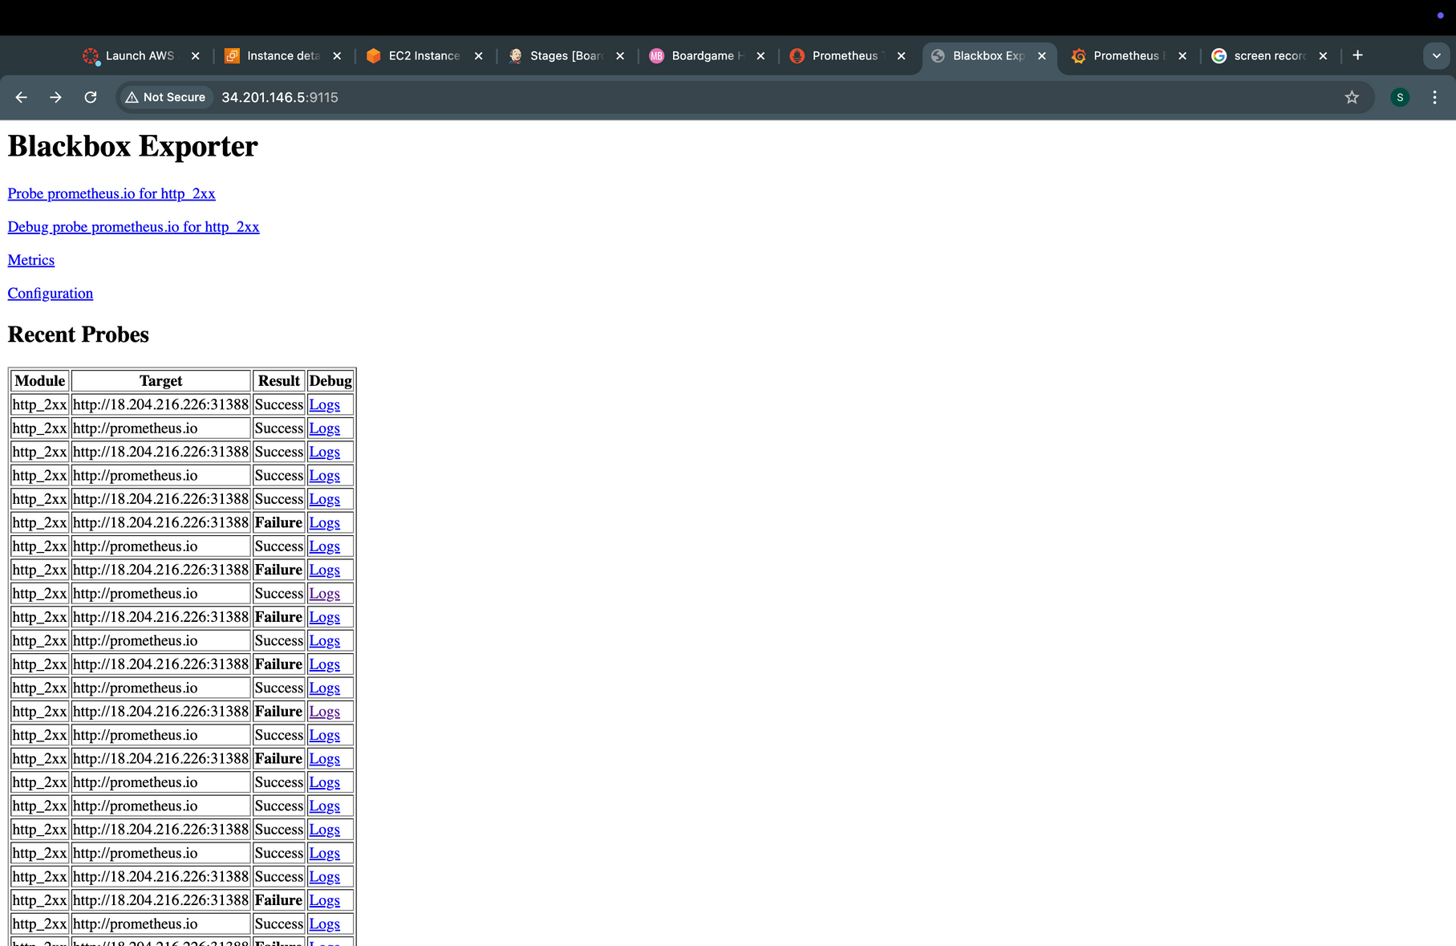
RESULT

Slide 13
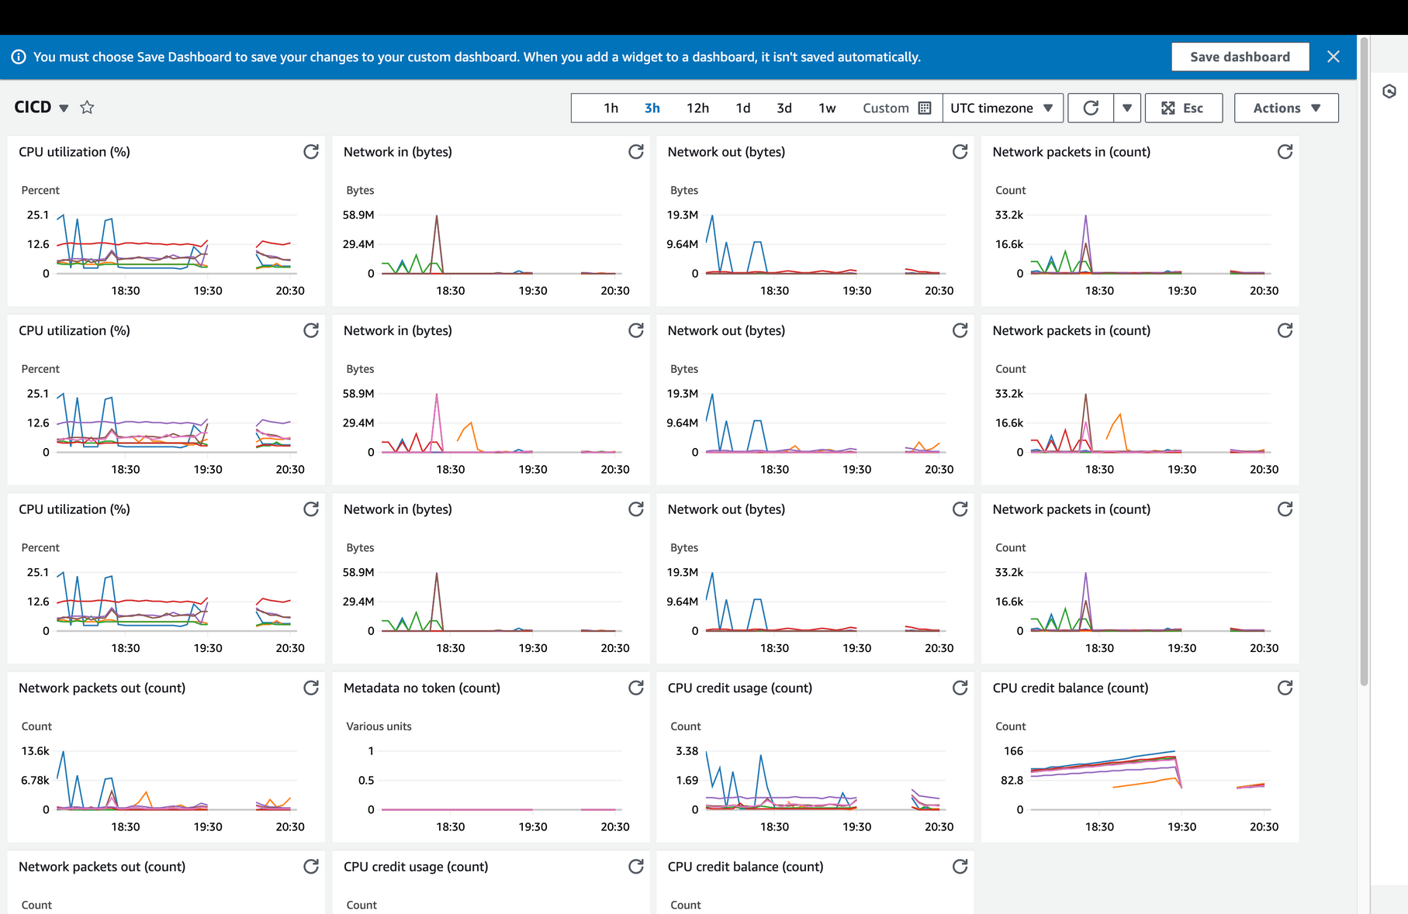
Traditional Analysis dashboard

Slide 14
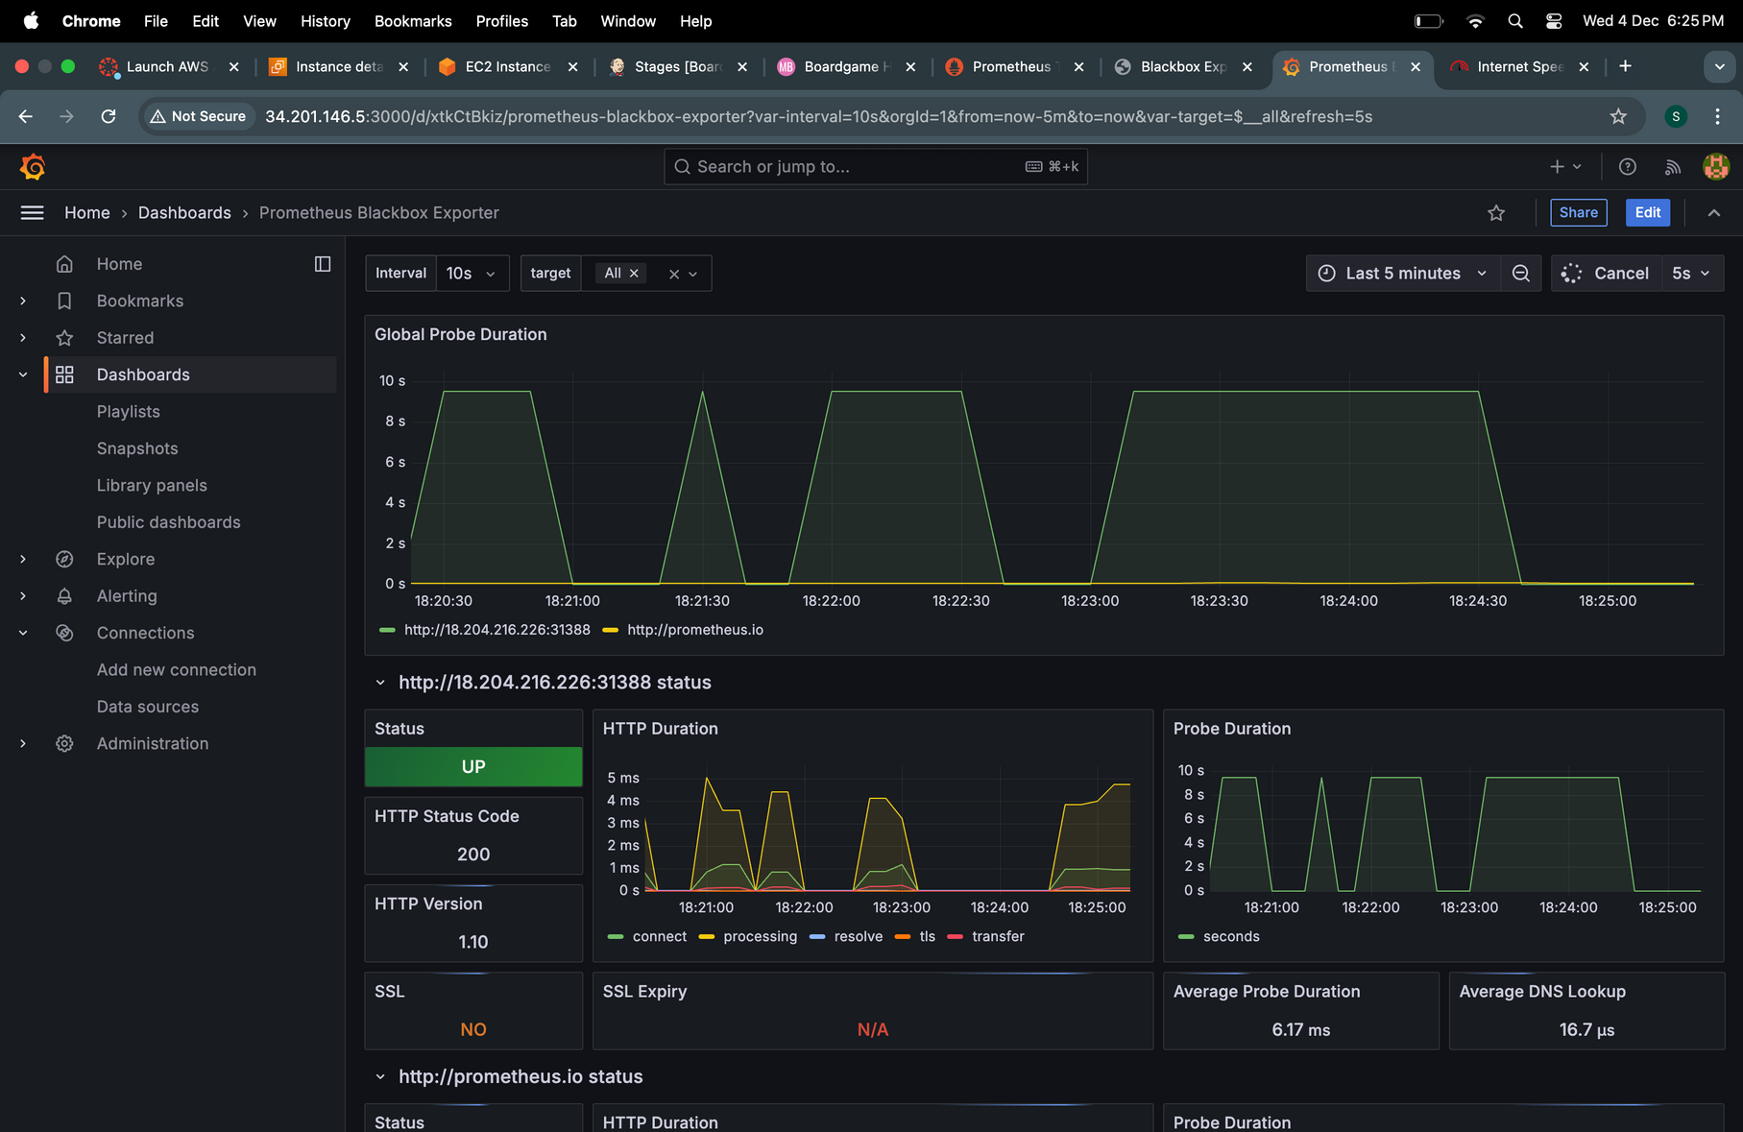
Grafana Dashboard

Slide 15
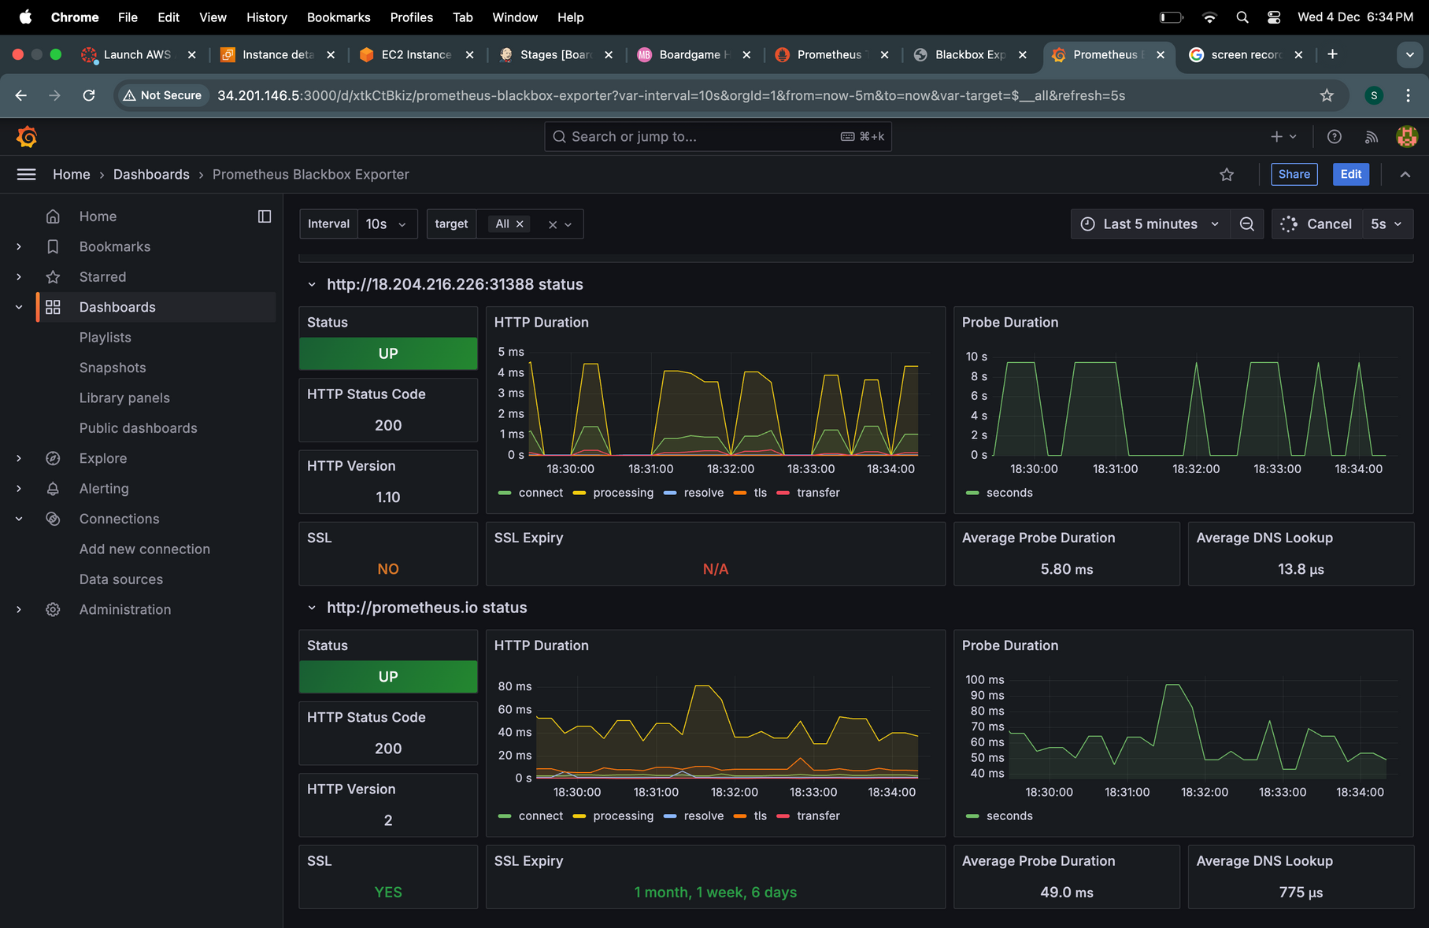
RESULT

Slide 16


RESEARCH AND DEVELOPMENT
Seamless Integration and Automation:
Successfully implemented a robust CI/CD pipeline, streamlining the software delivery lifecycle.
Achieved end-to-end automation from code integration to production deployment.
Security and Reliability:
Incorporated advanced security measures, including vulnerability scans and role-based access controls (RBAC).
Delivered a secure and scalable deployment infrastructure.
Enhanced Monitoring and Alerts:
Deployed real-time monitoring with Prometheus and Grafana, ensuring operational transparency.
Configured alert systems to minimize downtime and ensure high availability.
Scalable and Future-Ready:
Built an adaptable pipeline framework suitable for evolving corporate needs.
Enabled faster and more reliable software releases, setting a foundation for continuous improvement.
Conclusion

Slide 17

Thank You
RESEARCH AND DEVELOPMENT

